Slide 1


International University
MICRO-PROCESSING SYSTEM
Lecture 10:
ADC, DAC and Sensor Interfacing
Vo Minh Thanh, M.Eng
School Of Electrical Engineering

Slide 2
Analog-to-digital Converter (ADC)
Digital computers use binary (discrete) values, but in the physical world everything is analog (continuous).
A physical quantity is converted to electrical (voltage, current) signals using a device called a transducer.
Transducers are also referred to as sensors. Sensors for temperature, velocity, pressure and light etc produce an output that is voltage (or current).
Therefore, we need an analog-to-digital converter to translate the analog signals to digital numbers so that the microcontroller can read and process them.
An ADC samples an analogue signal at discrete times, and converts the sampled signal to digital form.

Slide 3
Major Characteristics of the ADC
Resolution
The ADC has n-bit resolution, where n can be 8, 10, 12, 16, or even 24 bits. Higher-resolution ADCs provide a smaller step size, where step size is the smallest change that can be discerned by an ADC.
Although the resolution of an ADC chip is decided at the time of its design and cannot be changed, we can control the step size with the help of what is called V_{ref}.
n-bit | Number of steps | Step size (mV)
8 | 256 | 5/256 = 19.53
10 | 1024 | 5/1024 = 4.88
12 | 4096 | 5/4096= 1.2
16 | 65,536 | 5/65,536 = 0.076
Table 13-1: Resolution versus Step Size for ADC (V_{ref} = 5 V), (V_{cc} = 5 V)

Slide 4
Major Characteristics of the ADC
Conversion Time
Conversion time is defined as the time it takes the ADC to convert the analog input to a digital (binary) number.
The conversion time is dictated by the clock source connected to the ADC in addition to the method used for data conversion and technology used in the fabrication of the ADC chip such as MOS or TTL technology.
Reference Voltage ( V_{ref} )
V_{ref} is an input voltage used for the reference voltage.
The voltage connected to this pin, along with the resolution of the ADC chip, dictate the step size.
For an 8-bit ADC, the step size is V_{ref}/256 because it is an 8-bit ADC, and 2 to the power of 8 gives us 256 steps.

Slide 5
Major Characteristics of the ADC
If the analog input range needs to be 0 to 4 volts, then V_{ref} is connected to 4 volts. That gives 4 V/256 = 15.62 mV for the step size of an 8-bit ADC.
if we need a step size of 10 mV for an 8-bit ADC, then V_{ref} = 2.56 V, because 2.56 V/256 = 10 mV.
For the 10-bit ADC, if the V_{ref} = 5V, then the step size is 4.88 mV
V_{ref} (V) | V_{in} Range (V) | Step Size (mV)
5.00 | 0 to 5 | 5/256 = 19.53
4.0 | 0 to 4 | 4/256 = 15.62
3.0 | 0 to 3 | 3/256 = 11.71
2.56 | 0 to 2.56 | 2.56/256 = 10
2.0 | 0 to 2 | 2/256 = 7.81
1.28 | 0 to 1.28 | 1.28/256 = 5
1 | 0 to 1 | 1/256 = 3.90
Step size is V_{ref} / 256
Table 13-2: V_{ref} Relation to V_{in} Range for an 8-bit ADC

Slide 6
Major Characteristics of the ADC
V_{ref} (V) | V_{in} (V) | Step Size (mV)
5.00 | 0 to 5 | 5/1024 = 4.88
4.096 | 0 to 4.096 | 4.096/1024 = 4
3.00 | 0 to 3 | 3/1024 = 2.93
2.56 | 0 to 2.56 | 2.56/1024 = 2.5
2.048 | 0 to 2.048 | 2.048/1024 = 2
1.28 | 0 to 1.28 | 1/1024 = 1.25
1.024 | 0 to 1.024 | 1.024/1024 = 1
Table 13-3: V_{ref} Relation to V_{in} Range for an 10-bit ADC
In some applications, we need the differential reference voltage where V_{ref} = V_{ref} (+) - V_{ref} (-). Often the V_{ref} (-) pin is connected to ground and the V_{ref} (+) pin is used as the V_{ref}

Slide 7
Major Characteristics of the ADC
Digital data output
In an 8-bit ADC we have an 8-bit digital data output of D0-D7, while in the 10-bit ADC the data output is D0-D9.
To calculate the output voltage, we use the following formula:
D_{out} = V_{in} / step size
Where
D_{out} = digital data output (in decimal),
V_{in} = analog input voltage
step size = (resolution) is the smallest change, which is
( V_{ref} / 256 ) for an 8-bit ADC.

Slide 8
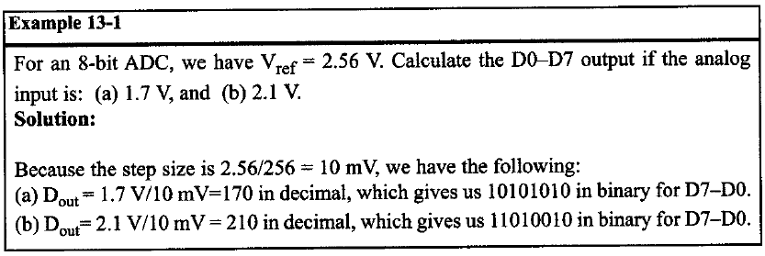
Major Characteristics of the ADC

Slide 9
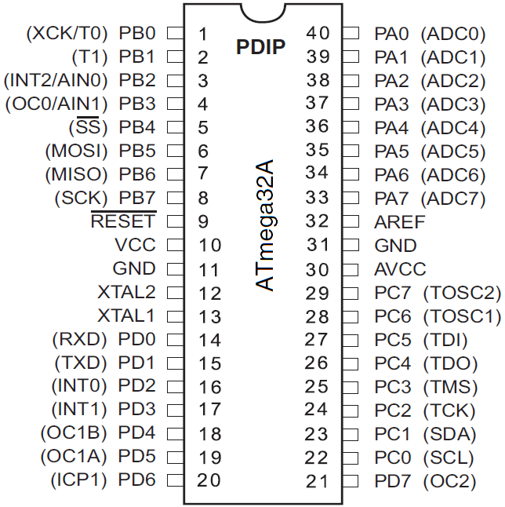
ATmega32 ADC features
It is a 10-bit ADC.
It has 8 analog input channels,
7 differential input channels, and
2 differential input channels with
optional gain of 10x and 200x.
The converted output binary data is
held by two special function regis-
ters called ADCL (A/D Result Low)
and ADCH (A/D Result High).
Because the ADCH:ADCL registers
give us 16 bits and the ADC data out is only 10 bits wide, 6 bits of the 16 are unused.

Slide 10
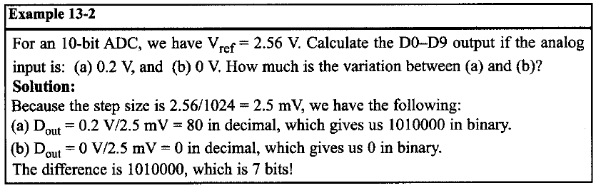
ATmega32 ADC features
We have three options for V_{ref}
V_{ref} can be connected to
AVCC (Analog V_{cc}) Internal 2.56 V Reference
External AREF pin
The conversion time is dictated by the crystal frequency connected to the XTAL pins (Fosc) and ADPS0:2 bits.

Slide 11
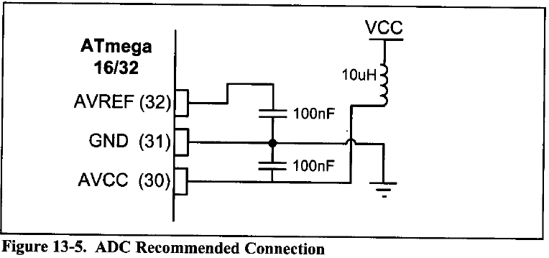
ADC Pins
The AVCC pin provides the supply for analog ADC circuitry. To get a better accuracy of AVR ADC we must provide a stable voltage source to the AVCC pin. Figure 13-5 shows how to use an inductor and a capacitor to achieve this.

Slide 12
ADC Programming in AVR
In the AVR microcontroller five major registers are associated with the ADC They are
ADCH (high data)
ADCL (low data)
ADCSRA (ADC Control and Status Register)
ADMUX (ADC multiplexer selection register)
SPIOR (Special Function I/O Register).

Slide 13
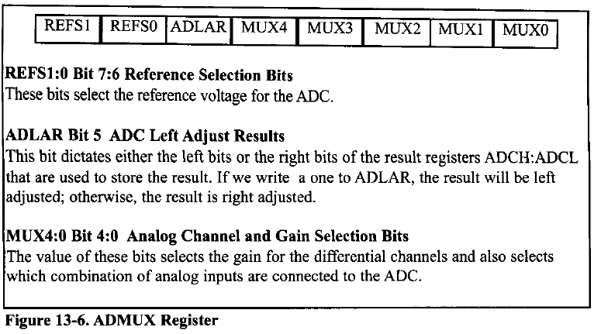
ADC Programming in AVR

Slide 14
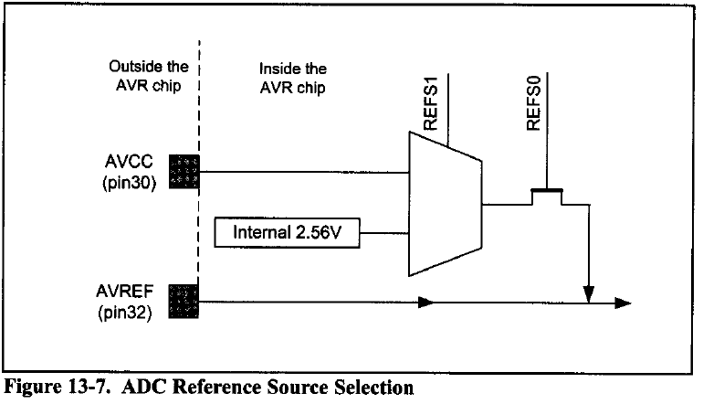
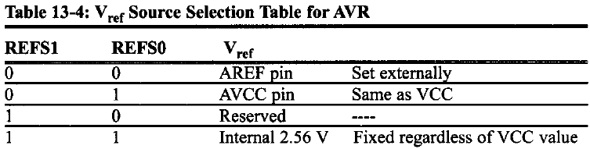

Slide 15
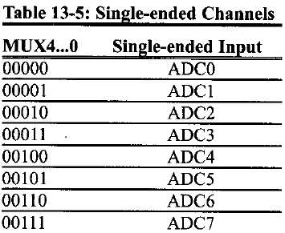
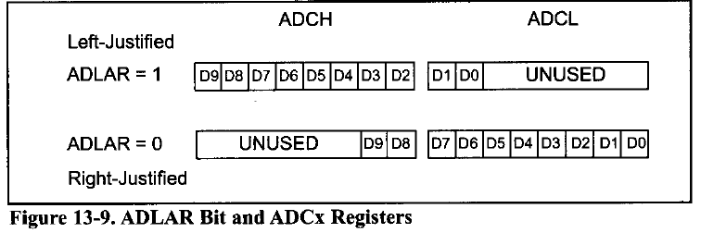

Slide 16
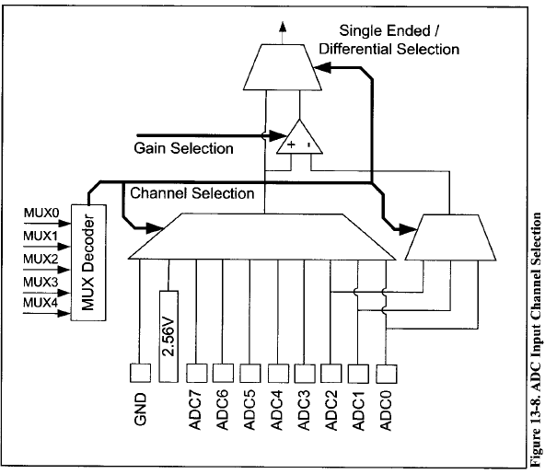

Slide 17
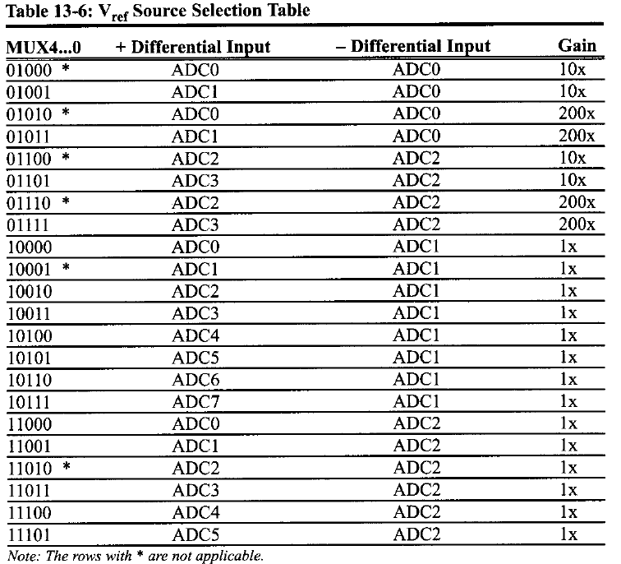

Slide 18
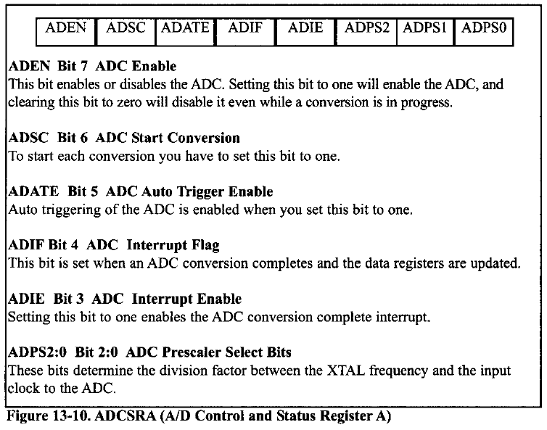

Slide 19
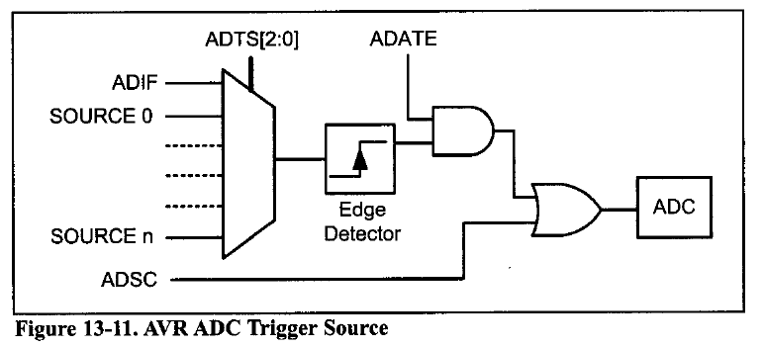
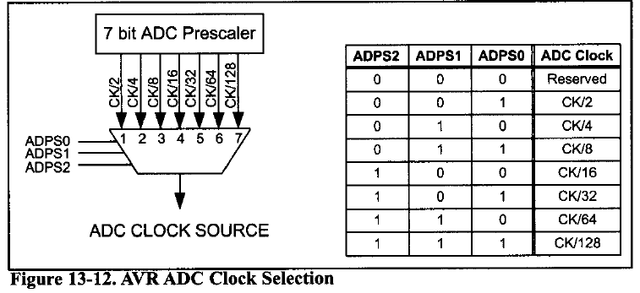

Slide 20
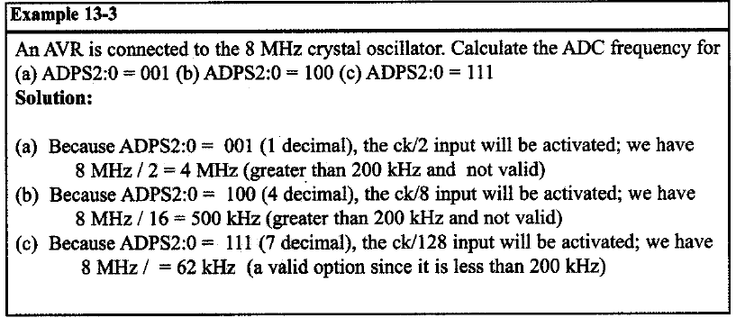
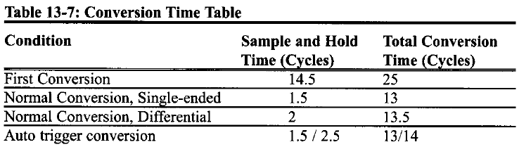
In AVR, Use less than 200KHz Clock Frequency in ADC for max accuracy

Slide 21
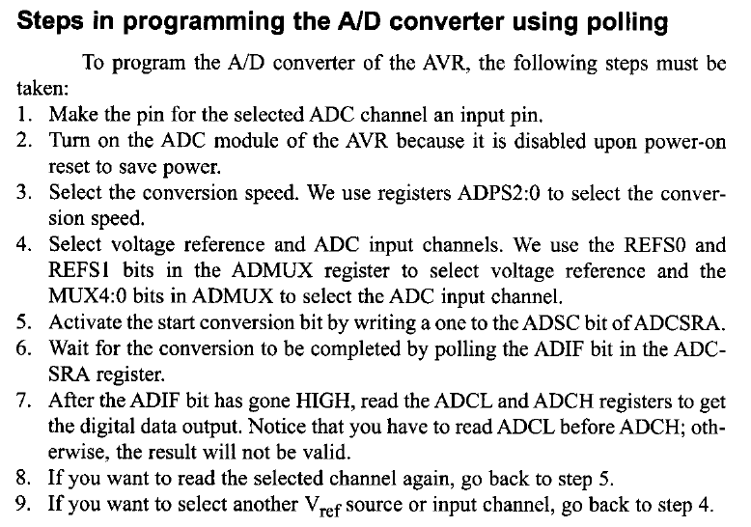

Slide 22
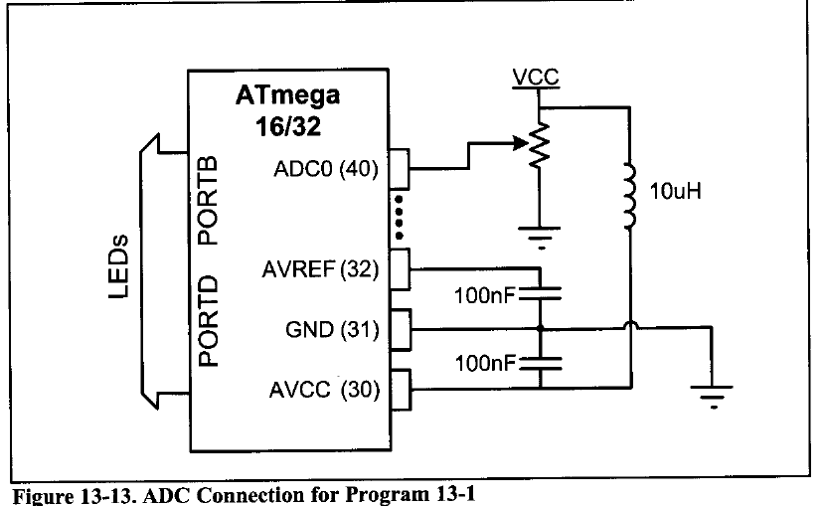

Slide 23
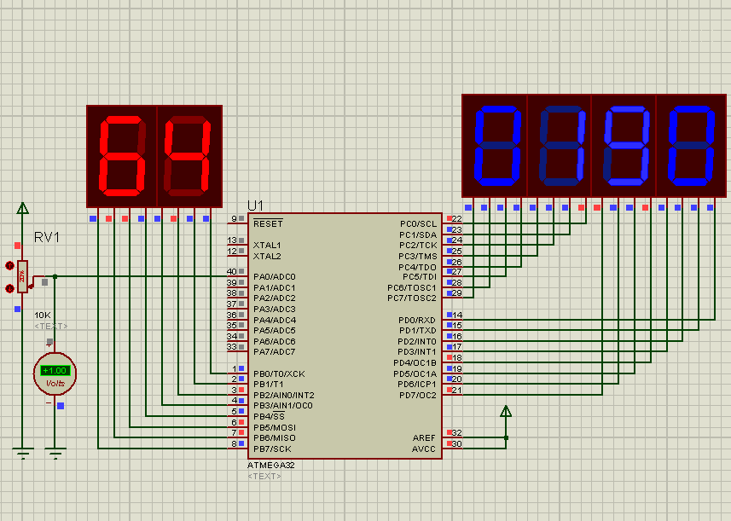
ADC Simulation

Slide 24
Reading ADC using Polling
// Reading ADC using polling
#include <avr/io.h> //standard AVR header
int main (void){
unsigned int data;
DDRB = 0xFF; // make Port B an output
DDRC = 0xFF; // make Port C an output
DDRD = 0xFF; // make Port D an output
DDRA = 0; // make Port A an input for ADC input
ADCSRA = 0x87; // make ADC enable and select CLK/128
// 2.56V Vref internal, right justified,
ADMUX = 0xC0; // select ADC Channel 0
while (1){
ADCSRA |= (1<<ADSC); // start conversion
while ( (ADCSRA & (1<<ADIF) )== 0 ); // wait to finish
data = ADC; // read 10-bit value
PORTD = data; // give the low byte to PORTD
PORTC = data >> 8; // give the high byte to PORTC
PORTB = data >> 2; // if u need only 8-bit value
}
return 0; }

Slide 25
Reading ADC using Interrupts
#include <avr/io.h> //standard AVR header
#include <avr/interrupt.h>
ISR(ADC_vect){
PORTD = ADCL; // give the low byte to PORTD
PORTC = ADCH; // give the high byte to PORTB
ADCSRA |= (1<<ADSC) ; // start conversion
}
int main (void){
DDRC = 0xFF; // make Port B an output
DDRD = 0xFF; // make Port D an output
DDRA = 0; // make Port A an input for ADC input
sei(); // enable global interrupts
// enable ADC and interrupt, and select CLK/128
ADCSRA= 0x8F;
// 2.56V Vref internal, right justified,
// select ADC0 chanel 0
ADMUX = 0xC0;
ADCSRA |= (1<<ADSC) ; // start conversion
while (1); return 0;} // wait forever

Slide 26
LM34 and LM35 Temprature Sensors
The output voltage is of LM34 is linearly proportional to the Fahrenheit temperature. It outputs 10 mV for each degree of Fahrenheit temperature.
Part Scale | Temp. Range | Accuracy | Output
LM34A | -50 F to +300 F | +2.0 F | 10 mV/F
LM34 | -50 F to +300 F | +3.0 F | 10 mV/F
LM34CA | -40 F to +230 F | +2.0 F | 10 mV/F
LM34C | -40 F to +230 F | +3.0 F | 10 mV/F
LM34D | -32 F to +212 F | +4.0 F | 10 mV/F
Table 13-9: LM34 Temperature Sensor Series Selection Guide

Slide 27
LM34 and LM35 Temprature Sensors
The output voltage is of LM35 is linearly proportional to the Celsius temperature. It outputs 10 mV for each degree of Centidgade temperature.
Part | Temp. Range | Accuracy | Output Scale
LM35A | -55 C to+150 C | +1.0 C | 10 mV/C
LM35 | -55 C to +150 C | +1.5 C | 10 mV/C
LM35CA | -40 C to +110 C | +1.0 C | 10 mV/C
LM35C | -40 C to +110 C | +1.5 C | 10 mV/C
LM35D | 0 C to +100C | +2.0 C | 10 mV/C
Table 13-9: LM35 Temperature Sensor Series Selection Guide

Slide 28
Interfacing the LM34, LM35 to the AVR
LM34 (or LM35) produces 10mV for every degree of temperature change and the ADC has 10-bit resolution with a maximum of 1024 steps.
if we use the step size of 10 mV, the V_{out} will be 10,240 mV (10.24 V) for full-scale output.
The maximum temperature sensed by the LM34 is 300 degrees F, and its highest is 3000mV (3.00V).
If we use the internal 2.56V reference voltage, the step size would be 2.56 V/1024 = 2.5 mV.
(10 mV/2.5 mV = 4) This is four times the real temperature
We can scale it by dividing it by 4 to get the real number for temperature

Slide 29
Interfacing the LM34, LM35 to the AVR
Temp. (F) | V_{in} (mV) | # of steps | Binary V_{out}(b9-bO) | Temp, in Binary
0 | 0 | 0 | 00 0000 0000 | 0000 0000
1 | 10 | 4 | 00 0000 0100 | 0000 0001
2 | 20 | 8 | 00 0000 1000 | 0000 0010
3 | 30 | 12 | 00 0000 1100 | 0000 0011
10 | 100 | 20 | 00 0010 1000 | 0000 1010
20 | 200 | 80 | 00 0101 0000 | 0001 0100
30 | 300 | 120 | 00 0111 1000 | 0001 1110
40 | 400 | 160 | 00 1010 0000 | 0010 1000
50 | 500 | 200 | 00 1100 1000 | 0011 0010
60 | 600 | 240 | 00 1111 0000 | 0011 1100
70 | 700 | 300 | 01 0001 1000 | 0100 0110
80 | 800 | 320 | 01 0100 0000 | 0101 0000
90 | 900 | 360 | 01 0110 1000 | 0101 1010
100 | 1000 | 400 | 01 1001 0000 | 0110 0100
Table 13-11: Temperature vs. V_{out} for AVR with V_{ref} = 2.56 V

Slide 30
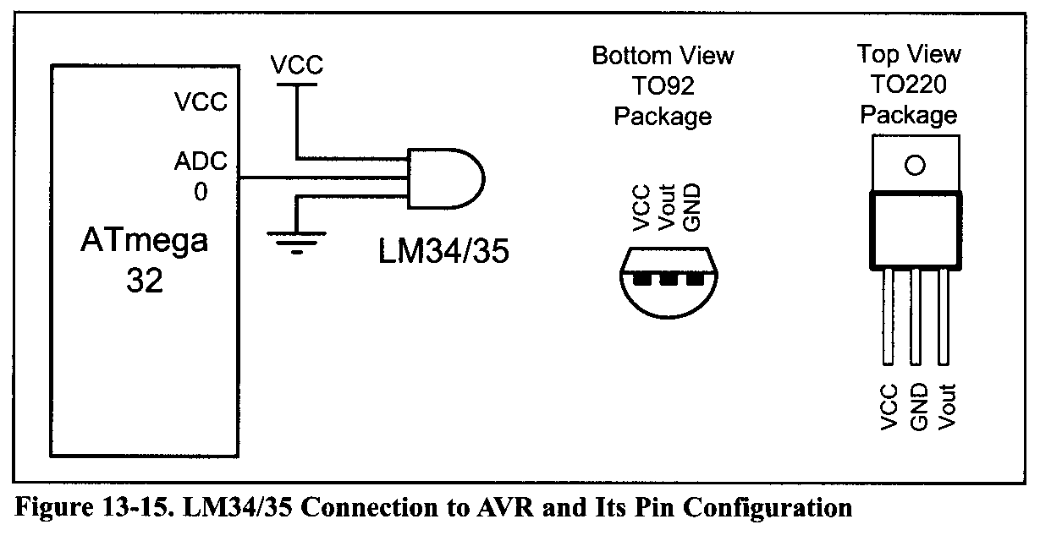
Interfacing the LM34, LM35 to the AVR

Slide 31
Reading and displaying temperature
The following points must be noted:
The LM34 (or LM35) is connected to Channel 0 (ADC0 pin).
The 10-bit output of the A/D is divided by 4 to get the real temperature.
To divide the 10-bit output of the A/D by 4 we choose the left-justified option and only read the ADCH register. It is same as shifting the result two bits right. See Next Example.

Slide 32
Reading and Displaying Temprature
// this program reads the sensor and displays it on PortD
#include <avr/io.h> //standard AVR header
int main (void)
{
DDRD = 0xFF; // make Port D an output
DDRA = 0X00; // make Port A an input
ADCSRA = 0x87; // make ADC enable and select CLK/128
ADMUX = 0xE0; // 2.56V Vref and ADC0
// data will be left-justified
while (1){
ADCSRA |= (1<<ADSC) ; // start conversion
while( (ADCSRA&(1<<ADIF))==0 ); // wait for end
PORTD = ADCH; // give the high byte to PortD
}
return 0;
}

Slide 33
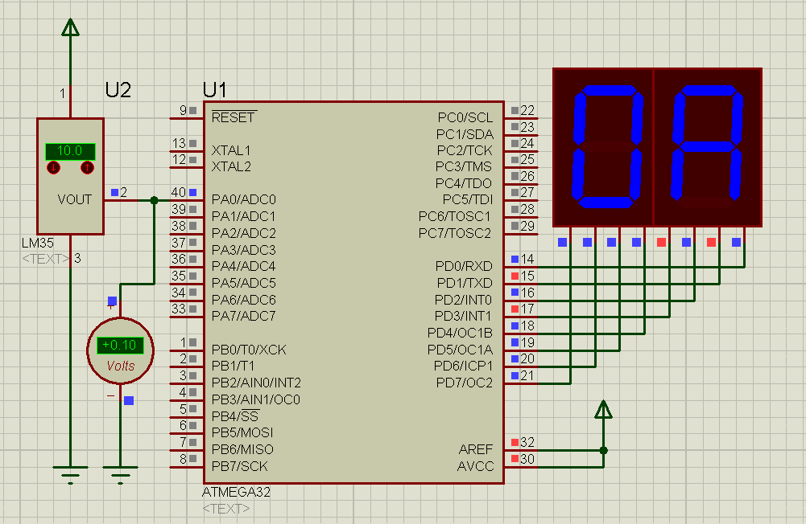
LM35 Simulation

